Slide 1
Energy efficient UDN design using reinforcement learning
DGIST
BongSang Kim
JaeHyun Lee
19/July/2019
UGRP Meeting

Slide 2
Progress
Design Env code
Design RL code – MCTS
Remodel based on sample library
Most of MCTS libraries are for sequential game
→ We decided to mcts.py module instead of using MCTS library
Make 2 module
main.py: UDNEnv(environment code)+MCTS(RL code)
ppp.py: BSposition.csv(information of BS position) create

Slide 3
System Model
Environment model
16-users and 10-BSs are deployed in the area
BS location is PPP
User location is uniform distribution which changes every step
전원 off 된 BS와 user까지의 거리를 infinity로 하여 association을 막음
MCTS model
Utilize MCTS library on Github
Most of MCTS libraries are for sequential game
We decided to edit the library for our environment model

Slide 4
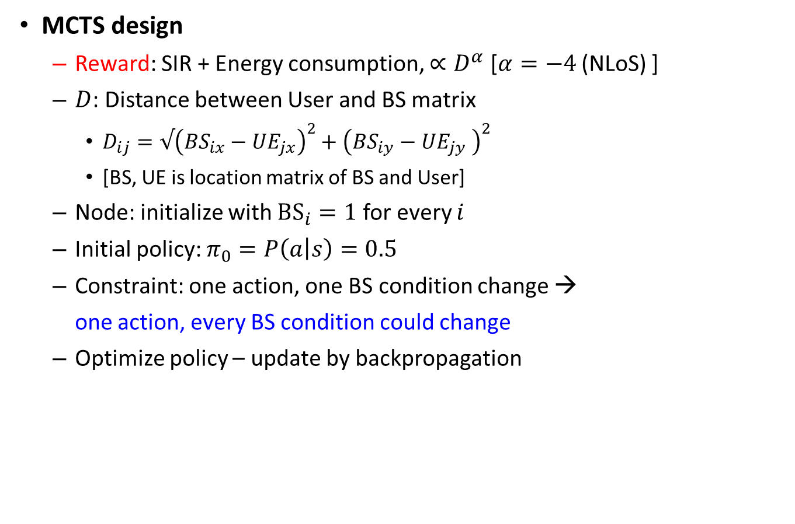
System Model
MCTS design
Reward: SIR + Energy consumption, $∝D^{α}$ [$α=−4$ (NLoS) ]
$D$: Distance between User and BS matrix
$D_{ij}=√{\left(BS_{ix}−UE_{jx}\right)}^{2}+{\left(BS_{iy}−UE_{jy} \right)}^{2}$
[BS, UE is location matrix of BS and User]
Node: initialize with ${BS}_{i}=1$ for every $i$
Initial policy: $π_{0}=P\left(a | s\right)=0.5$
Constraint: one action, one BS condition change →
one action, every BS condition could change
Optimize policy – update by backpropagation

Slide 5
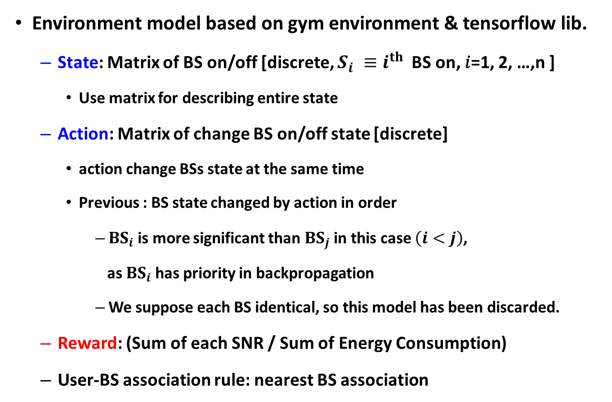
System Model
Environment model based on gym environment & tensorflow lib.
State: Matrix of BS on/off [discrete, $S_{i} ≡i^{th}$BS on, 𝑖=1, 2, …,n ]
Use matrix for describing entire state
Action: Matrix of change BS on/off state [discrete]
action change BSs state at the same time
Previous : BS state changed by action in order
${BS}_{i}$is more significant than ${BS}_{j}$ in this case $\left(i<j\right)$,
as ${BS}_{i}$has priority in backpropagation
We suppose each BS identical, so this model has been discarded.
Reward: (Sum of each SNR / Sum of Energy Consumption)
User-BS association rule: nearest BS association

Slide 6
System Model
Make 2 python module
main.py: UDNEnv(environment code)+MCTS(RL code)
ppp.py: create BSposition.csv(information of BS position)

Slide 7
System Model Structure
Class : UDNEnv
__init__
Initialize parameters, BS position, depthLimit
isTerminal
decide whether the state is terminal or not
step
$$calculate Bsdistance/EnergyConsumption/SNR/reward$$
Association
associate BS/UE by association rule
getPossibleAction
return list of every possible action
takeAction
return the state according to action
getReward
return the reward of specific state
render
Display the environment (not use)

Slide 8
System Model Structure
Class : mcts
__init__
initialize parameters
search
search Tree until iterationlimit
executeRound
update node/reward, do backpropagate)
selectNode
decide next node
expand
expand new node
Backpropagate
backpropagate the tree
getBestChild
find possible bestNodes
getAction
return action of bestnode
Notes:
DQN 짜서 MCTS 결과랑 비교하기 +좌표 시각화해서 BS가 켜지고 꺼지는거 잘 되었나 확인
Step에서 UE 초기화되는 건 환경이 달라지느 거니까 문제가 될 수 있다
UE가 확률로 어떤 방향으로 이동한다 정도가 ㄱㅊ을듯
SNR 에서 SIR로 바꾸세요 그게 좋을 거에요
Function approximation 빠졌네.
MCTS RL 논문 찾아보기
State에 user distance는 고려안한 이유가 있나요? 지금 on/off만 고려하면 brute force로 찾는거지 RL코드로 볼 수 있을까요.
그래프
State를 바꾸고 action은 그대로 써도 될듯
원래 node는 state기준임
BS가 000 -> 100 -> 000이 되면 000의 visitnum이 올라가냐요? 그렇게 하던가, 한번 끄꼬 켜면 다시 온오프 안디ㅗ게해서 그런 상황을 막던가 하시길
객체는 명확하게 분리되어야 유지보수하기 좋을 것
Import gym으로 gym make해서 돌아가게 해라는 말이었는데…
→cartpole 참고
__main__.py
MCTS.py
Gym.py
원래 있던 function이름 쓰는게 좋다
Reward가 어디지점부터 유익한 값인지 알려주는게 좋다
수식으로 계산해서 최대 optimal을 알아내서 할 수 도 있고
다른 알고리즘을 써서 비교해보고
Alphago zero 논문 읽어보고 mcts 이해하기
State는 user distnace등등 정보가 다 들어가야하는데 그러면 sate는 무한하게 되는데 단순한 mcts로는 힘들죠
Link 세기… los nlos probabililty

Slide 9
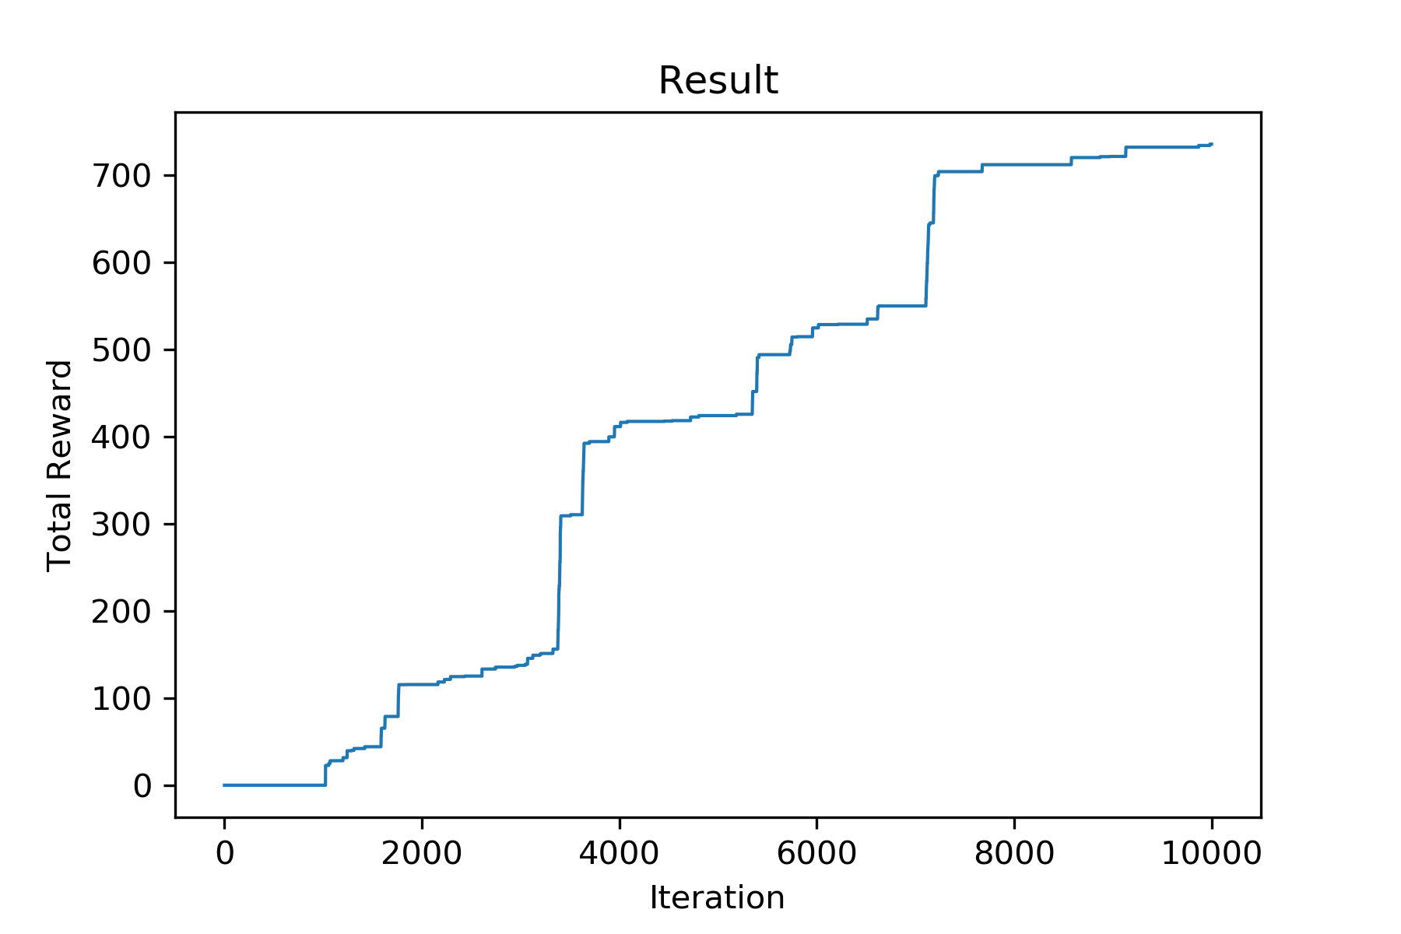
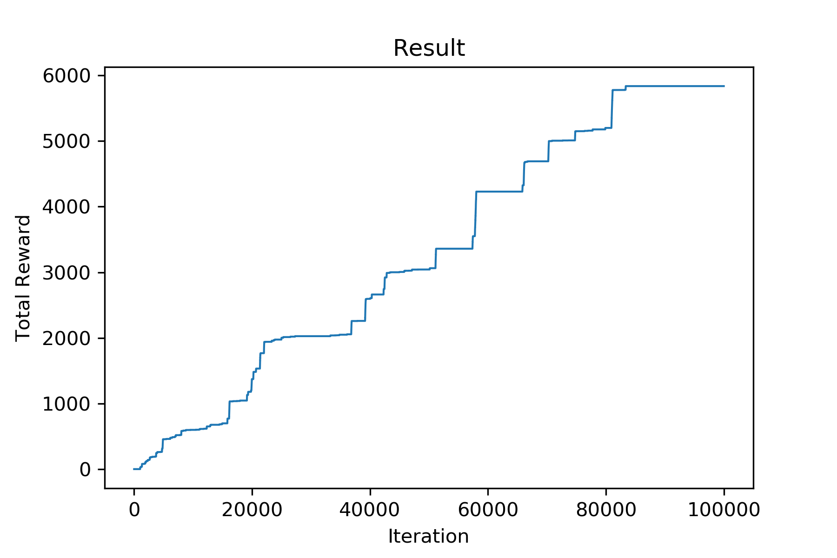
Result – 10,000 Iteration

Slide 10
Result – 100,000 Iteration

Slide 11
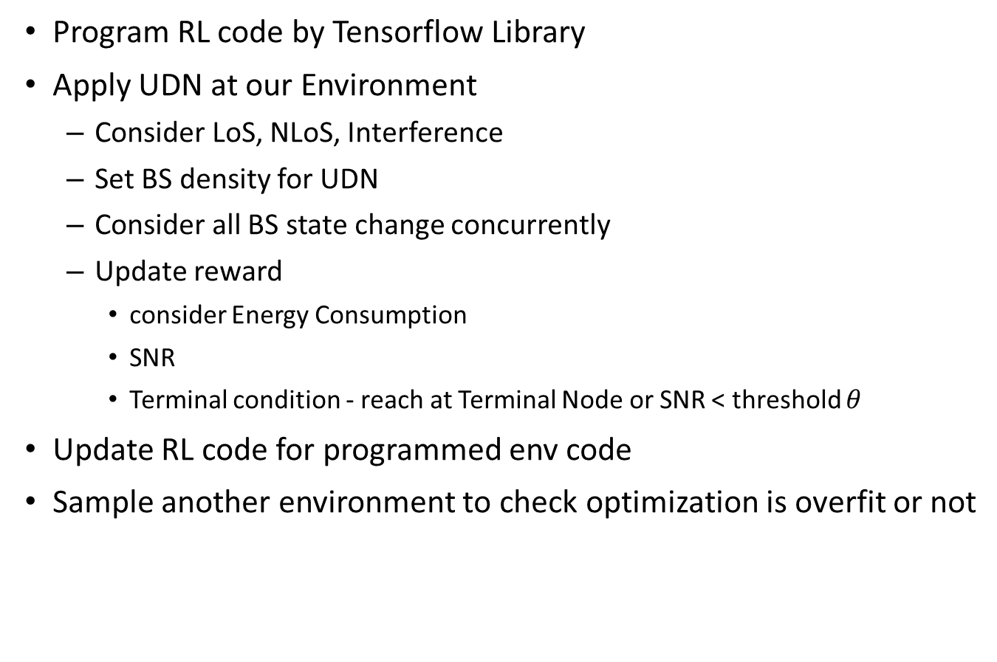
Future plan
Program RL code by Tensorflow Library
Apply UDN at our Environment
Consider LoS, NLoS, Interference
Set BS density for UDN
Consider all BS state change concurrently
Update reward
consider Energy Consumption
SNR
Terminal condition - reach at Terminal Node or SNR < threshold $θ$
Update RL code for programmed env code
Sample another environment to check optimization is overfit or not

Slide 12
Thank you
Any Questions?

